Slide 1
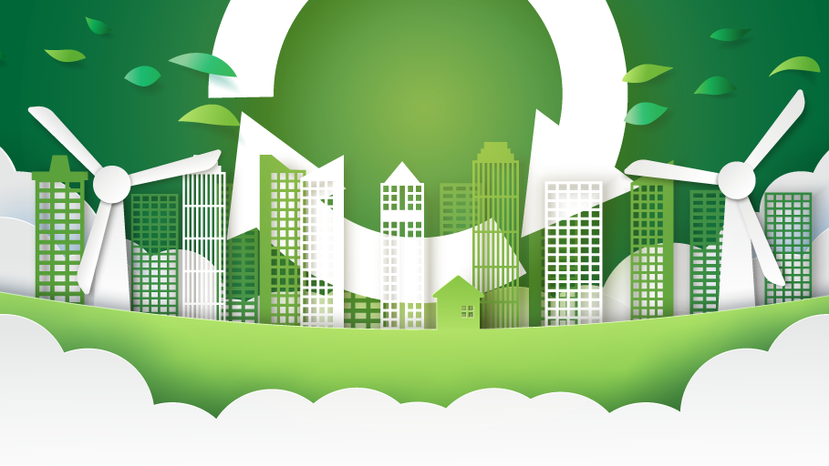
Simply ReUse
Team: Brian Spiewak, Lucianne Vazquez, Peyton Schlafley
November 19, 2020
Notes:
Reminders:
Good evening! And, Thank you for being here today.
Let me introduce myself and the team. My name is Lucianne. My team members are Peyton and Brian. We developed Simply ReUse. In this presentation, I’ll be reviewing the application, user story, and the breakdown of our tasks.
Brian will be covering an overview of the Technologies Used, Challenges, and Successes.
Peyton will be doing a Demonstration, an overview of Future Development, Links and closing the presentation.
We be answering any questions at the end.

Slide 2
APPLICATION
Description
Motivation
Simply ReUse is an app that targets users who want to learn more about recycling.
Key features include:
Recycling 101 – Educational information
View current news items about recycling
Create a profile - edit and delete their own comments
Search for recycling categories and items that can be taken to drop off locations
As a group we were inspired by our combined interest to help the world be a better place in reducing waste.
We want our users to be part of a community where they can stay up-to-date with recycling news and get involved in open discussion through comments
Notes:
Our application, Simply ReUse targets users who want to learn more about recycling.
Our motivation, is to help the world be a better place in reducing waste.
With so many great ideas floating out there, we want our users to be a part of a community where they can stay up-to-date with recycling news and get involved in open discussion by providing them with educational information, among other.
Next, I’ll review the user story
//profiles that allows them to create blogs and post their ideas to the community

Slide 3
USER STORY
Users view the application homepage with a call to action to learn more about recycling
Users can create a profile to view a blog community of articles about recycling
Once logged in, the user can post, edit and delete comments on the articles in our blog as well as respond to other user comments
When the user views the Recycle page, they can search recycling categories that will show them items that can be recycled as well as brief educational stats
Notes:
When a user views the application, they will be called to action to learn more about recycling.
A user can create a profile to view blogs and comment.
Once logged in, the user can post, edit and delete comments on the articles in our blog as well as respond to other user comments
Next, I’ll review how we separated tasks among the team members.

Slide 4
BREAKDOWN OF TASKS/ROLES
RACI Matrix
 | Peyton | Brian | Lucianne
GitHub | R | A | A
API | C/R | C/R | C
Heroku | C | R | C
Feature Routes/Models | R | C | C
Feature Front-End | C | R | C
Feature Auth | C | C | R
Proofread and Design | A | R | A
Presentation | A | R/A | R
Notes:
* Reminder: RACI stands for Responsible, Accountable, Consulted, & Informed
Some of the responsibilities of the team members are in the chart displayed above.
We divided the features based of availability.
Peyton was mainly responsible for the GitHub repository,
I worked on the Heroku deployment
Brian kept a good eye on changes, follow-ups and the project as a whole.
Thank you guys for all your hard work and effort.
Next, I’ll hand it over to Brian to review Technologies Used.

Slide 5
TECHNOLOGIES USED
Visual Studio Code
GitHub
Heroku
Node.js
Express.js
Handlebars.js
MySQL and the Sequelize ORM
HTML
CSS
JavaScript
MVC Framework
Authentication
Cookies & Express-Session
Notes:
Thank you Lucianne.
Good evening, My name is Brian. I’ll be reviewing the technologies we used, our Challenges throughout the past week and very gratifying successes to show you our MVP tonight
For Technologies Used, we of course used VS Code to write all code for our app.
GitHub was used to house our repository and Heroku to deploy our application.
Node.js and Express.js helped us to create a RESTful API including GET and POST routes for retrieving and adding new data
Handlebars.js, a template engine that we chose to use makes it easy to render great looking apps very effectively
MySQL and the Sequelize ORM were used to create and manage our database including the seed files that we used which I’ll explain more later
We used the MVC Framework file structure to make sure that our app is future proof and that any collaborators would be able to dive in and contribute if needed
Lastly, because our allows for user interaction, we also used authentication to protect user data through cookies and express-session
Next, I’ll be reviewing Challenges that our group faced.
Note if you get questions:
Express.js is a web framework that let's you structure a web application to handle multiple different http requests at a specific url. -- It is the node packet.
Node (or more formally Node.js) is an open-source, cross-platform runtime environment that allows developers to create all kinds of server-side tools and applications in JavaScript. ¹
Reference:
Express, Node and JS https://developer.mozilla.org/en-US/docs/Learn/Server-side/Express_Nodejs/Introduction

Slide 6
CHALLENGES/CONSTRAINTS
MVP of a full-stack application provided in 2 weeks time
Needs to be mostly complete in 10 days and team needs to complete project around work schedules, school, family and other responsibilities.
During this assignment, we were not given an API key that we had requested from Recycle Nation
Developed new idea to seed database with recycling categories and items instead of using an API
Used the Agile Methodology to fail fast and revise on multiple iterations to create an MVP (minimum viable product)
Notes:
One of our biggest challenge was that we wanted to create a fully functional application in 2 weeks while all of us have very busy schedules
Our other challenge was that Recycle Nation didn’t respond to provide us with their API. Neither did Goodwill.
In our research for another API we learned that Google Maps is too broad and costs money, then we learned that TomTom did not include recycling locations and Datasets from government filings didn’t yield results.
As I mentioned on the last slide, this is where we changed course and seeded our database on our own instead of kicking the tires of more APIs out there.

Slide 7
SUCCESSES
Great teamwork and coordination!
Successful MVP
Key Success Metrics
All criteria set and defined in the project scope are met | How many daily blog posts? (est. goal)
The application functions with 0 Errors | How many people view the news daily?
The user interface is liked by at least 2 classmates outside the team | How many people used our database to find items that can be recycled?
How many people have downloaded our app? (set initial est. goal) | How many people will continue to use the app after 7 days?
Notes:
Overall, our biggest success was that with great team-work and coordination we worked well together to deliver our MVP of the Simply ReUse app to share with you all tonight
If our project were going live to the general population, we would measure our success criteria with the amount of hits our application garners as well as the amount of views, google searches, and revisits
And with that, I’ll hand it over to Peyton who will demonstrate our application.

Slide 8
DEMO
Notes:
Thank you, Brian.
I’ll be providing the demonstration, discussing future developments and closing our presentation.
This is our application … describe what you do as you click around showing the functionality.

Slide 9
FUTURE DEVELOPMENT
Add Recycle Nation API or location-based search
Ability to save favorite blog posts, recycling locations
Ability to share via social media, email/text to a friend(s) and family
Gain sponsorship from waste and recycling companies
Could expand to:
Educate how to reduce waste, how to recycle well, and how long things take to decompose
Search for refill and zero waste shops in the area
Search for repurpose textiles/clothing such as consignment shops, Goodwill, etc.
Add arts and crafts articles or videos created from recycled or repurposed goods
Notes:
For future development, we want to add location search, favorites, share features, and gain sponsorship.
From there, we can expand to education, shops, and arts and crafts.
Next, I wanted to share links so it’s easily accessible for everyone to view our app and code in more detail if you would like.

Slide 10
LINKS
Deployed App on Heroku https://simplyreuse.herokuapp.com/
GitHub repository
https://github.com/pschlafley/Simply-ReUse.git
Project Charter is in GitHub repo
https://tinyurl.com/SimplyReUse
Notes:
These are our links to the deployed application on Heroku, our GitHub repo and lastly, our project charter can also be found in the repo or the link above

Slide 11
Simply ReUse
THANK YOU!!
Notes:
In closing, I want to Thank you for your attention.
And, remember to Simply ReUse
Are there any questions?

